Slide 1
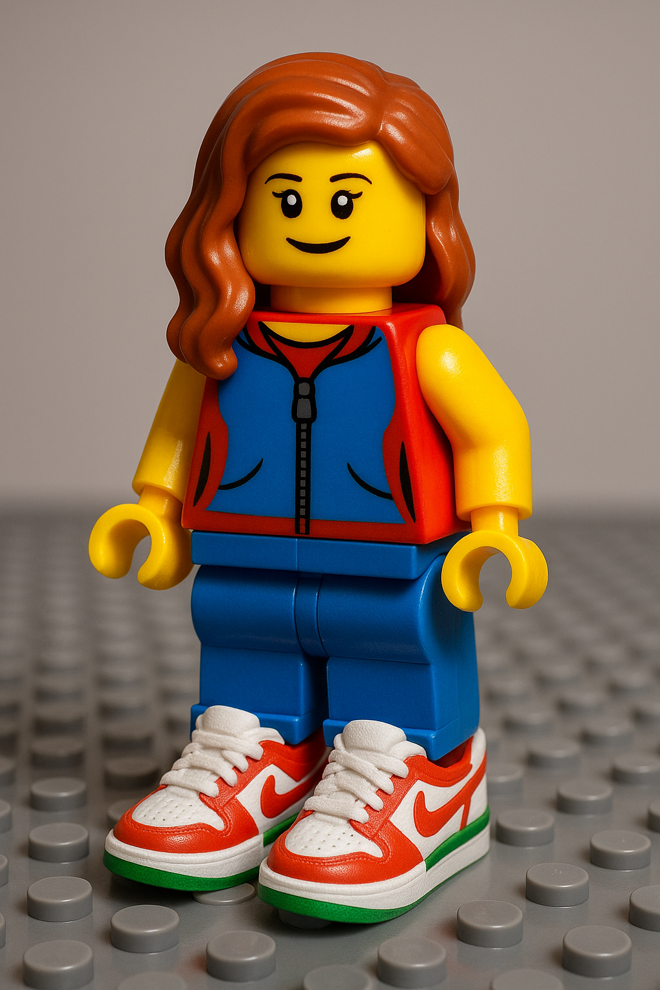
Upcycling, recycling, customization and trade mark exhaustion
SARAH
Sarah van den Brande
Attorney-at-law
Partner at Liedekerke – Belgium
Notes:
Thank you
My name is Sarah van den Brande and let me and my customized alter ego in a Lego whisk you away to the recycling, upcycling, and customizing of brands We’re here to test the limits of trademark exhaustion

Slide 2
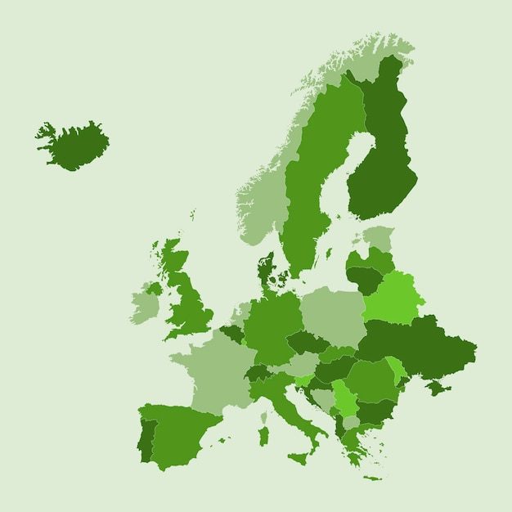
Setting the scene
Sustainability in EU policy (Green Deal)
Circular economy:
Circular economy
EC’s Circular Economy Action Plan
Key concepts: recycle, upcycle, customization
EC’s Circular Economy Action Plan
Key concepts: recycle, upcycle, customization
Circular economy:
Tension between fundamental rights
freedom of expression (art 11 EU Charter); freedom of arts (art 14); right to environmental protection (art. 37)
versus
right to (intellectual) property (art. 17)
Notes:
We might almost forget amid all the geopolitical turbulence, but for several years now Europe has been immersed in an ambitious Green Deal. The traditional throwaway economy must gave way to a circular economy.
So welcome key concepts like recycling, upcycling, and customization.
This growing movement toward reuse gives rise to tensions, particularly when branded products are modified or altered.
On the one hand, there are fundamental rights such as freedom of expression, artistic freedom, and the right to environmental protection. On the other hand, property rights—including intellectual property—must also be safeguarded.

Slide 3
Legal framework
Infringement
(a) Double identity
(b) Likelihood of confusion (even if post-sale)
(c) Detriment to distinctiveness, reputation or unfair advantage (free riding)
Defense
(1) No use as a TM
(2) Exhaustion
(3) Referential use
Notes:
First I am going to give
Here, I provide a schematic overview of concepts you are already familiar with, in particular that trademark infringement may take different forms, as well as the available defenses.
Defense 1: I am not using the sign as a Trademark
Defense 2: ALternatively I am, but TM rights are exhausted
Defense 3: Lastly I can rely on the exception of referential use
Concreet betekent dit voor upcyclers en recyclers :
Ze mogen geen commerciële band met de merkhouder suggereren
2) geen ongerechtvaardigd voordeel halen uit de reputatie van het merk: dus opletten met reclame
3) geen verwarring creëren over authenticiteit van de producten: niet zeggen dat er iets 100% origineel is als dat niet het geval is. Dus zeker bij het herstel / upcycling van producten belangrijk: goed aanduiden wat er niet origineel is.
In de praktijk leidt dat tot wat vaak “discreet gebruik” wordt genoemd: het woordmerk gebruiken om je diensten te beschrijven, duidelijk maken dat je onafhankelijk bent en alles wat verder gaat brengt je snel in de problemen.
Ook in de VS zien we dat terug, bijvoorbeeld in de zaak tussen Chanel en What Goes Around Comes Around, waar een reseller, maar ook restauranteur en upcycler niet zo lang geleden werd veroordeeld omdat hij de indruk wekte deel uit te maken van het officiële distributienetwerk van chanel: hij maakte daarbij statements als “100% authentic Chanels”, terwijl ze soms waren hersteld of waren bewerkt, hij gebruikte Chanel banners, en in de kortingcodes ook “Chanel”.: Merkinbreuk en oneerlijke MP veroordeling.

Slide 4
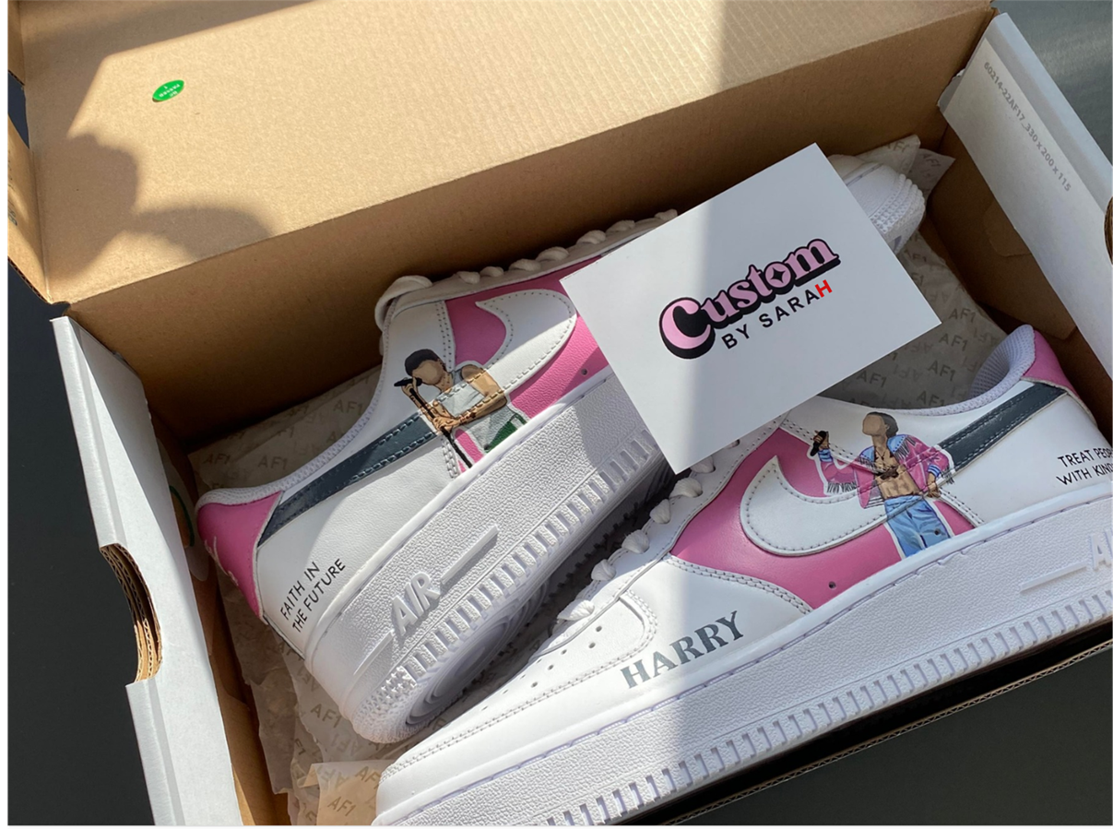
Defense 1 - No use as a TM
right to oppose the unauthorized use, in the course of trade, of a sign identical (or confusingly similar) to a TM in relation to goods and services
Commercial activity
≠ Private: no problem
Notes:
Defense line no. 1: No use of the sign as a trademark
For example, I have customized my Nike sneakers purely for personal use. In that case, there is no trademark infringement, as there is no commercial activity.
This defense is, of course, less attractive for upcyclers and recyclers with commercial ambitions.

Slide 5

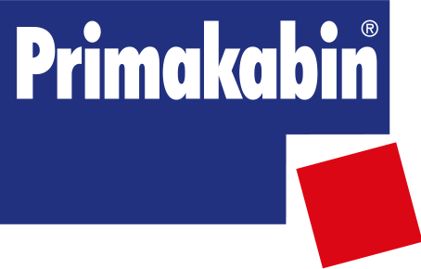

Defense 2 - Exhaustion
Principle
rights exhausted after first sale in EEA
Exception:
- Legitimate reasons
  Minor changes due to time : OK
  External non-trivial modifications : TM revive
- Other reasons: E.g. impression of a commercial link
Notes:
Defense line no. 2: Where there is commercial activity – exhaustion of trademark rights
As you know, trademark rights are exhausted after the first sale in the European Economic Area (EEA) by or with the consent of the trademark owner.
However, there are exceptions.
The trademark owner may still oppose the further commercialization of its products where there are “legitimate reasons” to do so.
What exactly are these?
1) The condition of the goods is changed or impaired
What does this mean? After all, second-hand markets, recycling, and upcycling inherently involve modifications to goods. Does this imply that trademark rights can never be exhausted in such contexts?
The answer is no.
In Portakabin v Primakabin (CJEU, 2010), the Court confirmed that trademarked goods may be marketed as “used” or “second-hand”—this is not problematic in itself.
Similarly, in the Valeo decision of the Benelux Court of Justice, it was made clear that minor changes resulting from age or normal use do not constitute trademark infringement.
Therefore, only alterations resulting from external intervention that are more than purely insignificant may revive the trademark owner’s rights, which seems a fair and reasonable approach.
2) Other legitimate reasons
In addition to changes affecting the condition of the product, there are other legitimate reasons that may allow the trademark owner to oppose further commercialization.
For example, this is the case where a recycler or upcycler creates the false impression of a commercial link between themselves and the trademark owner.
In this respect, the BMW v Deenik judgment (1999) is particularly relevant: one must not create the impression of being part of the trademark owner’s official distribution network.

Slide 6

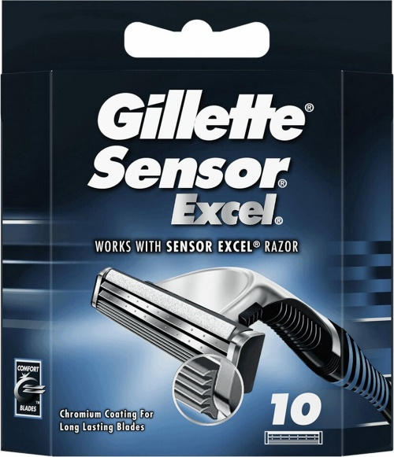
Defense 3 - Referential use
Use TM in the course of trade is allowed for the purpose of identifying or referring to goods or services TM owner (art. 14 EUTMD - CJEU BMW/Deenik)
⬄
Fair practices (CJEU Gilette)
Must not imply commercial link
No unfair advantage of distinctive character or repute
No discredit or denigration
No presentation as imitation
Notes:
3) If the second line of defense also fails: referential use of the trademark
If trademark rights are not exhausted, the exception for referential use of a trademark may still be relevant.
Under Article 14 of the Trade Mark Directive, a third party may use a trademark where this is necessary to refer to the goods or services of the trademark owner.
A classic example, again from BMW v Deenik, is that a garage specializing in the sale and repair of BMW cars may describe itself as an independent “BMW specialist” for those services.
However, and this is essential, such use must comply with honest practices in industrial and commercial matters, as further clarified in Gillette v LA-Laboratories.
In practical terms, this means that upcyclers and recyclers:
Must not suggest any commercial link with the trademark owner.
Must not take unfair advantage of the reputation of the trademark, particular care is required in advertising.
Must not create confusion as to the authenticity of the products. For example, one should not claim that a product is “100% original” if this is not the case. This is especially important in the context of repair or upcycling: any non-original elements should be clearly indicated.
In practice, this leads to what is often referred to as “discrete use”: using the word mark only insofar as necessary to describe one’s services, clearly indicating one’s independence, and avoiding anything that goes beyond this, as it may quickly give rise to legal issues.
A similar approach can be observed in the United States. For instance, in the case between Chanel and What Goes Around Comes Around, a reseller—also active as a restaurateur and upcycler—was recently found liable for trademark infringement and unfair competition. The court held that the company created the impression of being part of Chanel’s official distribution network, notably by using statements such as “100% authentic Chanel,” even where products had been repaired or altered, as well as by using Chanel-branded banners and promotional codes

Slide 7
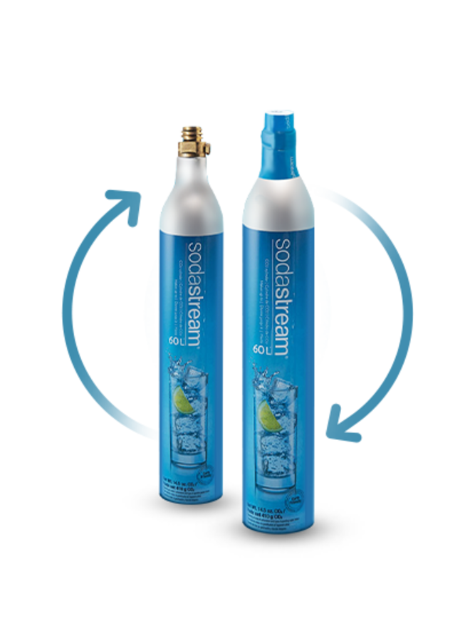
Recent case law
1) Recycling
SodaStream (CJEU 27 October 2022)
  Bottles refilled and relabelled with the original TM
  TM holder can oppose unless false impression of an economic link
  Bottles have not necessarily the same commercial origin as the gas
Notes:
Let us now examine how these principles have recently been applied in case law on recycling, upcycling, and customization. For each concept, I will discuss one recent example.
However, before doing so: although all of these concepts revolve around reuse and creativity, each has its own distinct meaning. These definitions are not fixed in legislation or case law, so we must rely on general understandings.
Recycling essentially refers to the reuse of materials or products, for example by refilling bottles or restoring furniture.
Let’s have a look how these principles have been applied in recent case law in recycling, upcycling and customization matters.
Recycling means reusing raw materials, by refilling bottles, refurbishing sofas
And the first case I want to discuss is the SodaSteam case of the Court of Justice.
The SodaStream case before the Court of Justice is an important decision on co-branding and trademark exhaustion in the context of product recycling. SodaStream sells home carbonation devices with reusable bottles bearing its trademarks. In Finland, the company MySoda collected empty SodaStream bottles that had already been placed on the EU market, and thus in principle exhausted refilled them with CO₂, and replaced the original labels with its own, while leaving the engraved SodaStream marks visible.
SodaStream used two different versions of its own labels: a pink one with caps Sodastream on it and a white label with carbon dioxide
SodaStream claimed trademark infringement, arguing that MySoda was selling refilled bottles with its marks without permission. The Finnish Supreme court asked the Court of Justice whether a trademark owner can object when reusable goods are refilled and re-labelled by a third party, while the original mark remains visible.
The Court held that in principle, the trademark owner cannot oppose further commercialisation of such goods, as long as the new labelling does not create the false impression of an economic link between the reseller and the trademark holder. This must be assessed globally, considering the labels, the product itself, sector practices, and consumer understanding.
A key point: because these bottles are designed for repeated reuse and refilling, they are not automatically seen as having the same commercial origin as the gas they later contain. The Court explicitly brought sustainability and the circular-reuse logic into its reasoning—suggesting that environmental goals can limit the circumstances in which trademark exhaustion can be “revived.”
The Court of Justice, following its Viking Gas reasoning, noted that keeping the original trademark visible on the bottle suggests the reseller did not alter the product in a way that masks its origin.
Overall, the SodaStream judgment shows the Court’s intention to promote competition in downstream markets—especially for refilling products needed for the operation of branded devices.
Hence the importance of a clear label

Slide 8
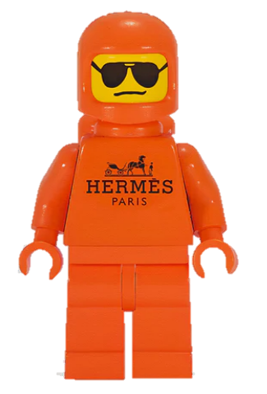
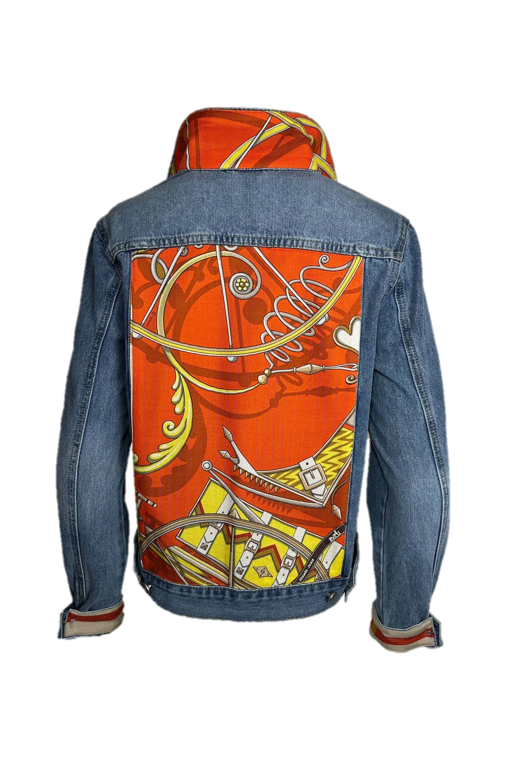
2) Upcycling
Hermès / Upcycler
(Paris 10 April 2025)
Court: upcycling = transformation in commercial context, no exhaustion
Hermès scarves reused
in Levi's jackets
Artistic right/referential use defense: rejected
Notes:
Upcycling refers to the transformation of products into items of higher value, often on a larger scale.
To date, no case law is known in the Benelux concerning upcycling in the context of trademark law.
In France, however, a first decision on upcycling has recently been issued. Hermès brought proceedings against an upcycler for infringement of, inter alia, its trademark rights. The designer sold upcycled Levi’s denim jackets incorporating iconic Hermès silk scarves. The Hermès trademark was also used on the website and Instagram, including in tags.
On 10 April 2025, the Paris Court of First Instance—true to French tradition—ruled largely in favor of Hermès.
Importantly, our lines of defense were indeed addressed in that decision:
First line of defense: not applicable, given the clear commercial context.
Exhaustion of rights: rejected by the court, as the scarves had been incorporated into the jackets. This constituted a transformation and therefore an unauthorized reproduction in a commercial context.
Referential use: also rejected, as it was clear that the jackets themselves were being marketed and that the trademark was used to promote the sale of the jackets, not merely to refer to the scarves.
The arguments based on freedom of artistic expression and environmental protection were likewise explicitly dismissed. According to the court, the jackets did not add any substantial artistic contribution beyond the original Hermès design, and sustainability considerations do not justify unauthorized commercial use of protected works.
The court placed strong emphasis on the commercial purpose and rejected the alleged necessity of using the trademark as a reference. Hermès was used as a trademark, not merely in a referential manner.
Damages and measures imposed:
€54,000 for economic loss;
€80,000 for infringement of moral rights and trademark rights (€40,000 per defendant);
€30,000 for saved investments;
€40,000 for unfair competition and parasitism.
In addition:
A prohibition on the infringing activities, subject to a penalty of €5,000 per day per infringement;
Publication of the judgment in three press outlets chosen by Hermès (up to €10,000 per publication), as well as a permanent story on the defendants’ website and Instagram pages for three months, in both French and English;
€30,000 in compensation pursuant to Article 700 of the French Code of Civil Procedure.

Slide 9

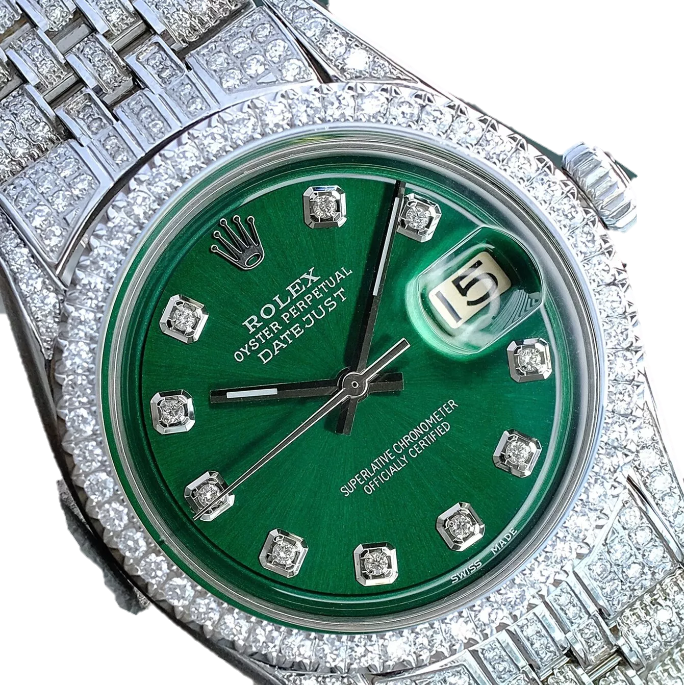

3) Customization
Rolex / Timeline
Dutch Ent. Brussels 7 July 2021
Swiss court 18 Jan 2024
Customized watches with ROLEX TM
+
on website (TM and pictures)
Antwerp company customizes ROLEX
luxury watches: icing
Legal action filed by ROLEX
Notes:
We have discussed refurbishment and upcycling. Let us now turn to customization. While it is similar to upcycling, it is not the same: customization involves personalizing products to meet individual preferences.
In this area, there is case law in Belgium and in Switzerland regarding luxury watches.
Some years ago, jewellers decided original Rolex watches could use some extra bling and started to add diamonds using a so-called “icing” technique.
In promoting their services and products, they sometimes went far by using original Rolex promotional and product images, including references to the brand and its logo, on their website.
Rolex was, unsurprisingly, not pleased and initiated legal proceedings in Belgium and abroad.

Slide 10

LAWFUL
Customization made upon customers’ requests, on their watches:
*ROLEX’s TM rights exhausted
*Owners free to customize their watches: private use
*Owners also free to have a third party customize their watches
Commercialization of stock customized watches:
*Commercialization of branded products lies within the monopoly of TM owners
*ROLEX’s TM rights not exhausted since watches have been modified without ROLEX’s consent
UNLAWFUL
Using original promotional and product images (with TM Rolex) => infringing copyright ROLEX
Reference on website => OK
Notes:
Both the Brussels Court and a Swiss Court drew a distinction between two approaches:
Personalized service
The customization of a Rolex at the request of a customer. The courts held, consistent with Rolex’s own position, that this is acceptable. After all, it concerns the customer’s own Rolex, and they are free to have diamonds added if they so wish. Timeline may offer such services. In this context, the trademark rights are exhausted, as the watches are modified at the customer’s request.
Commercial sale
The sale of pre-customized Rolex watches. The courts found that this constitutes an infringement of Rolex’s trademark and copyright. In such cases, what is being sold as a “Rolex” is no longer entirely a Rolex, and trademark rights are not exhausted. The quality function of the trademark is no longer guaranteed.
With regard to advertising:
Permitted:
Jewellers were allowed to use the Rolex name and logo on their website in connection with the sale of second-hand Rolex watches. A key factor was that it was clearly indicated that the watches were second-hand → exhaustion applies.
Timeline was also allowed to offer its “icing” services on the website in the context of customer requests and to refer to the trademarks
→ referential use.
Not permitted:
The use of original promotional and product images featuring the Rolex logo → copyright infringement in the photographs; exhaustion does not apply.
The use of the figurative Rolex trademark to advertise customized watches.
Interestingly, the court did not provide a clear ruling on the extent to which Timeline was allowed to use the logo to promote its services

Slide 11
Overview
recycling/ refurbishing
yes
upcycling
?
customization
no? → service vs. product (Rolex)
Notes:
Key takeaways
For recyclers: feel free to proceed, but do not suggest any commercial link with the trademark owner. Emphasize your independence and be transparent when non-original parts are used. A disclaimer may be helpful in this context.
Upcyclers generally find themselves in a less favorable legal position than recyclers. This is not surprising: upcycling typically involves more substantial modifications to the product, thereby adding value. The real issue lies in the commercial use, for which current case law in neighboring jurisdictions offers little to no workable solution.
Customizers, for their part, must wait for the initiative to come from the consumer. They may promote their services using references to trademarks, but may only apply those services to products for which the trademark rights have already been exhausted. Otherwise, they risk undermining the quality function of the trademark.

Slide 12

Questions?
s.vandenbrande@liedekerke.com

